Slide 1
Digital Signal and Image Management Project
Luca Galli, Davide Ronchi

Slide 2
Table of contents
01
02
03
Human Activity Recognition
Facial Emotion
Recognition
1D signals
2D signals
VIP lookalike
Image retrieval

Slide 3
01
Human Activity Recognition

Slide 4
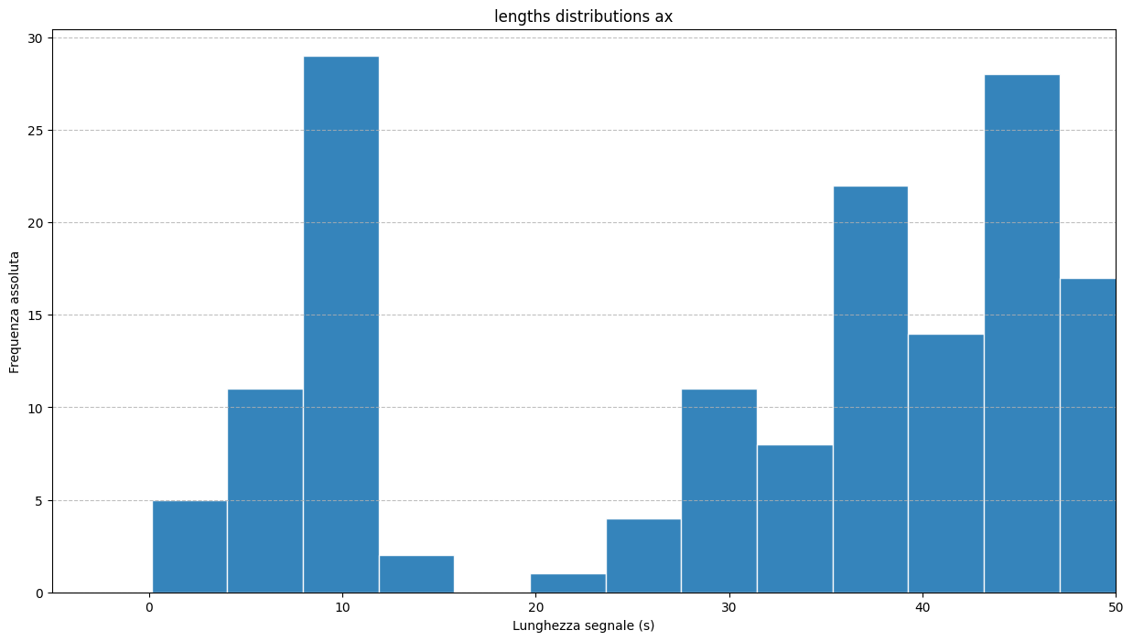
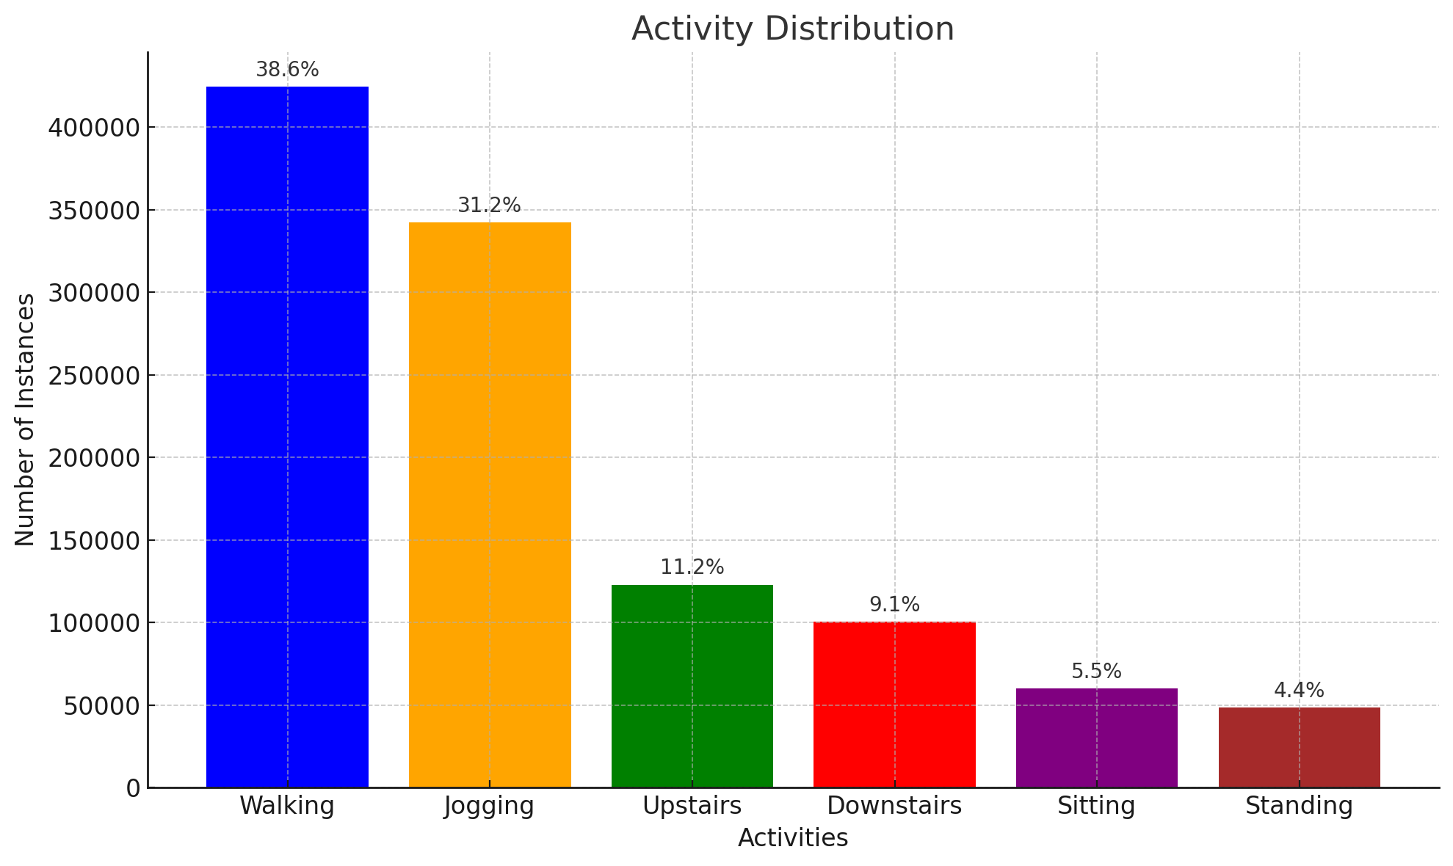
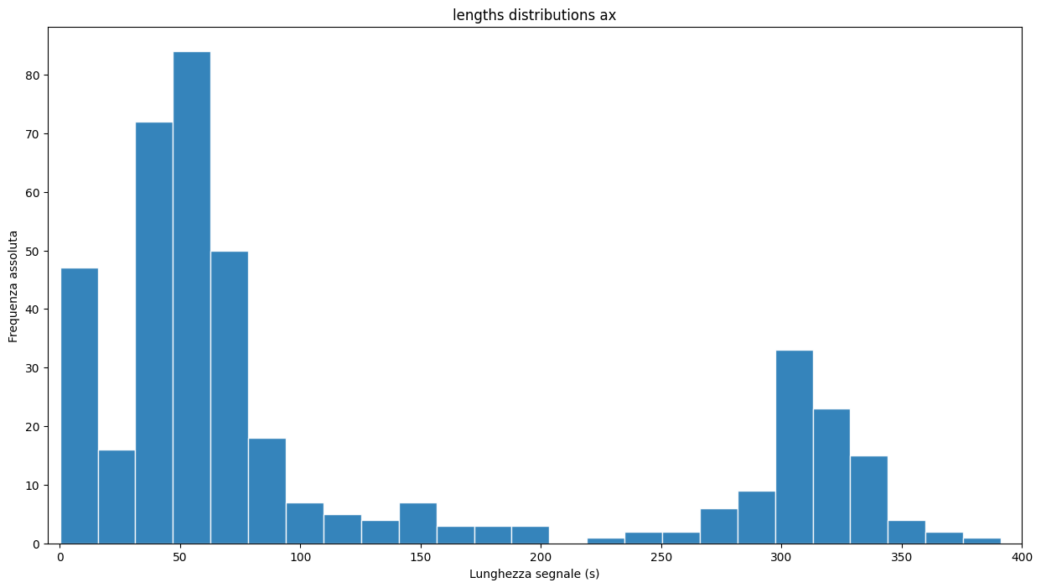
Dataset
WISDM: WIreless Sensor Data Mining (controlled conditions)
20Hz
Jennifer R. Kwapisz, Gary M. Weiss and Samuel A. Moore (2010). Activity Recognition using Cell Phone Accelerometers, Proceedings of the Fourth International Workshop on Knowledge Discovery from Sensor Data (at KDD-10), Washington DC. [PDF]

Slide 5
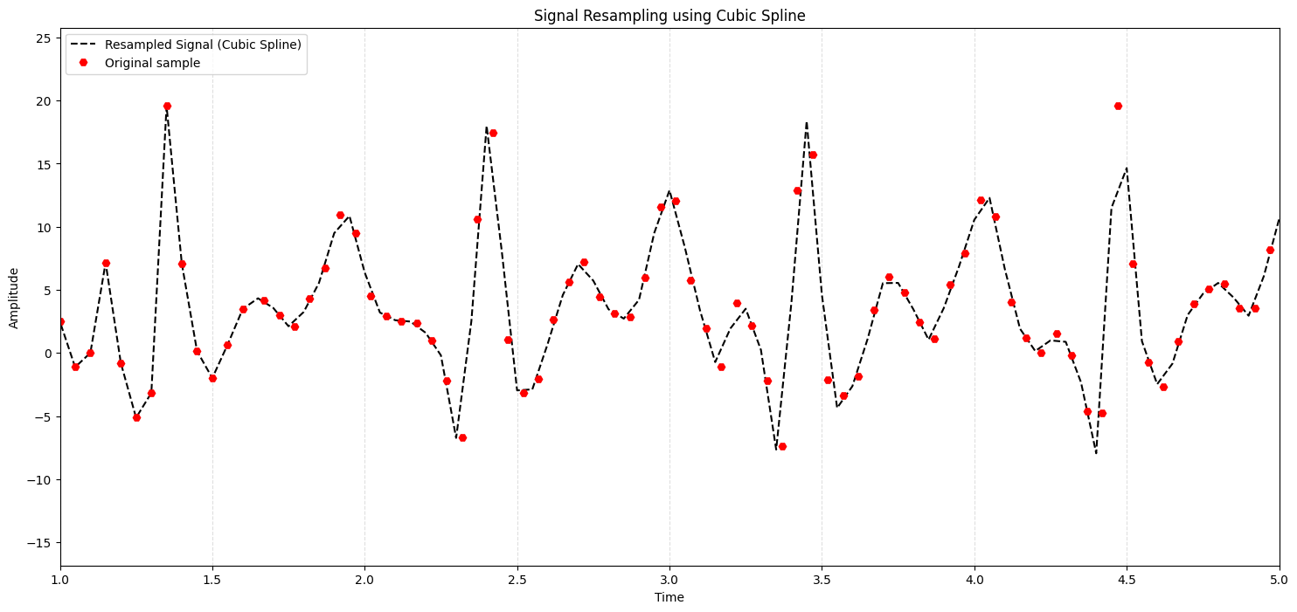
Resampling (20Hz)

Slide 6
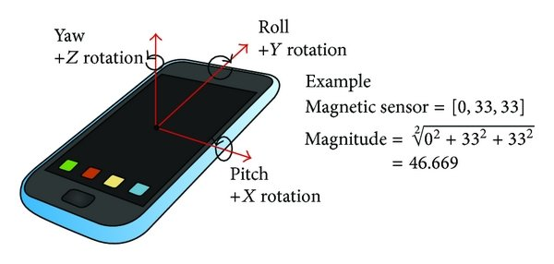
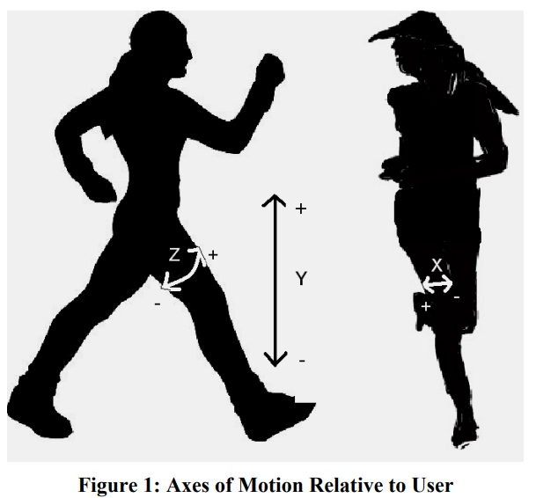
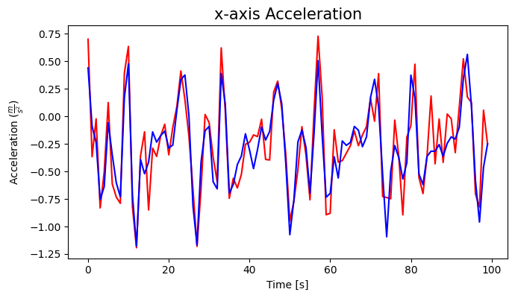
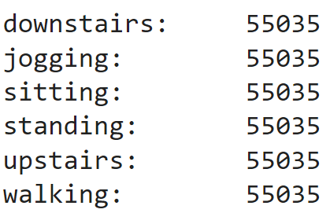
Augmentation
Random rotations (from normal dist.):
X-axis: 180° with max 10° offset
Y-axis: 180° with max 20° offset
Z-axis: 180° with max 30° offset
Jittering (from normal dist. with 0.2 sd)

Slide 7
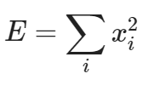
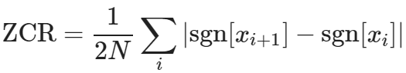
SVM (with feature extractors)
Energy
FFT
Mel Spectrogram
Discrete Fourier Transform
Mel Scale
ZCR
Spectrogram
Frequencies spectrum

Slide 8
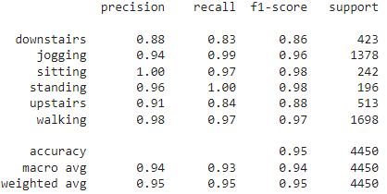
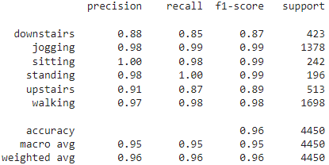
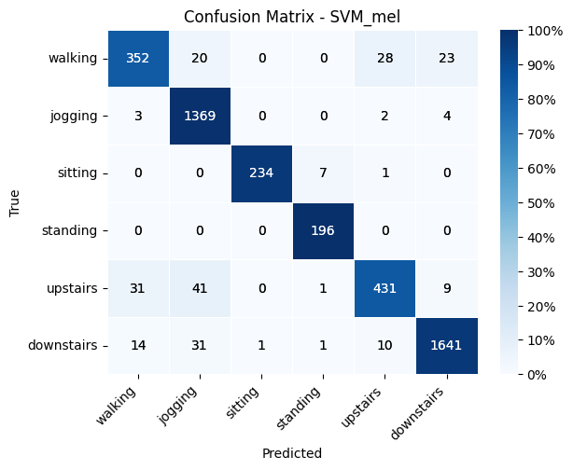
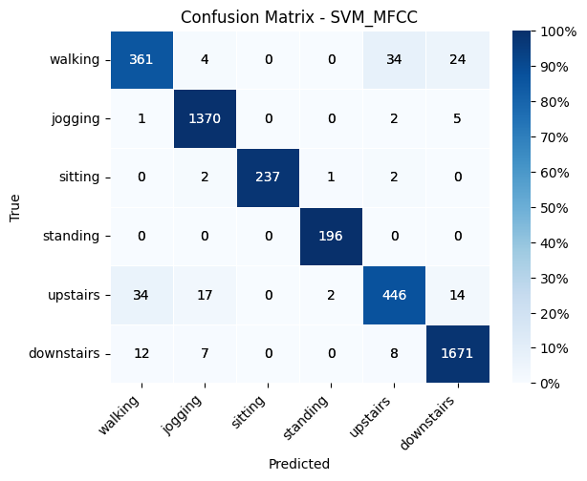
Mel
MFCC

Slide 9
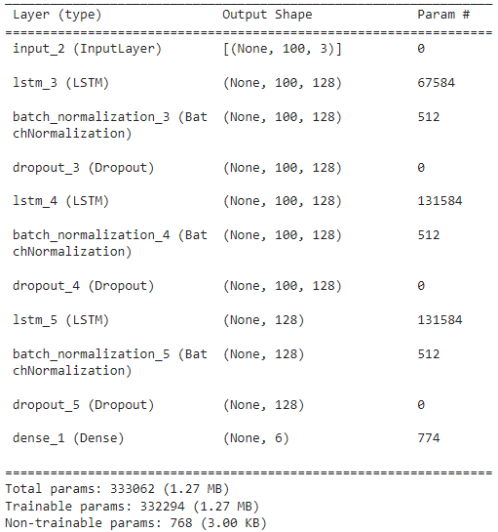
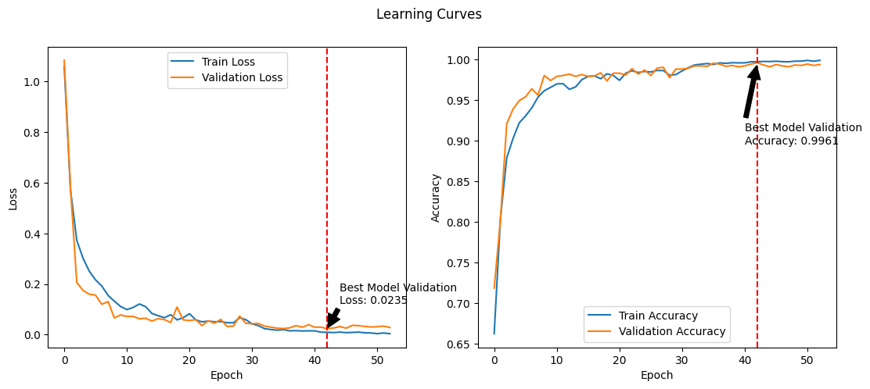
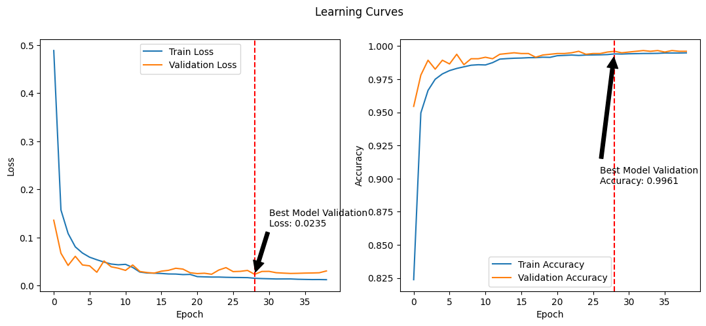
LSTM
Not augmented (validation)
Augmented (validation)

Slide 10
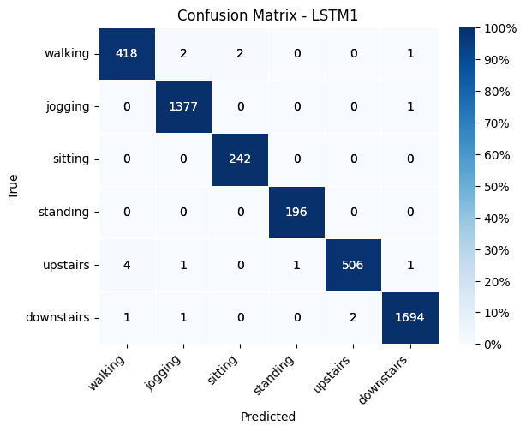

LSTM
Not augmented (test)
Augmented (test)

Slide 11

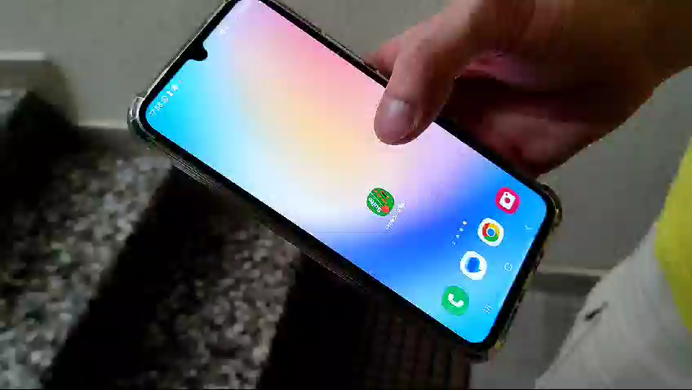

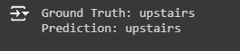
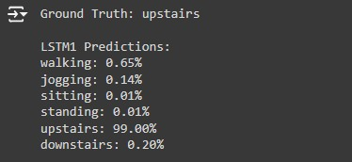
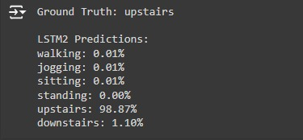
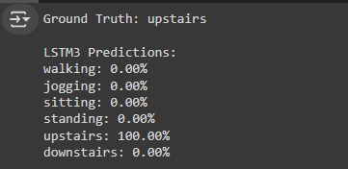
DEMO Activity Tracking
Physics Toolbox Sensor Suite
MFCC SVM
LSTMs

Slide 12
02
Facial Emotion Recognition

Slide 13
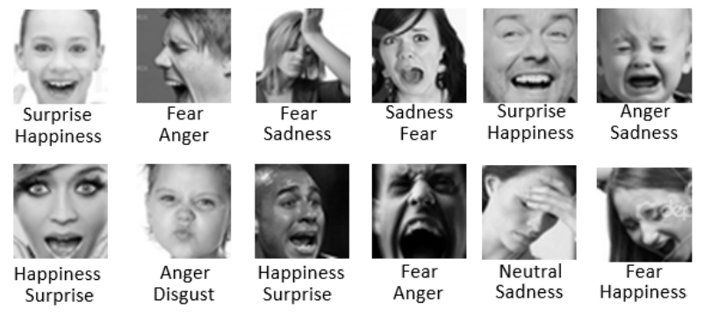
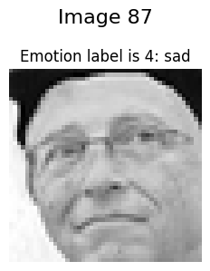
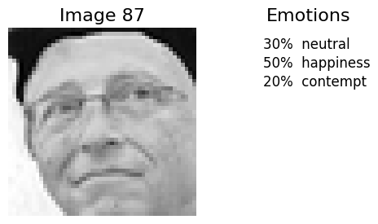
Dataset
Emotion FER+ (~36000)
FER
FER+
10 crowd-sourced taggers
Large scale crowd-sourcing

Slide 14
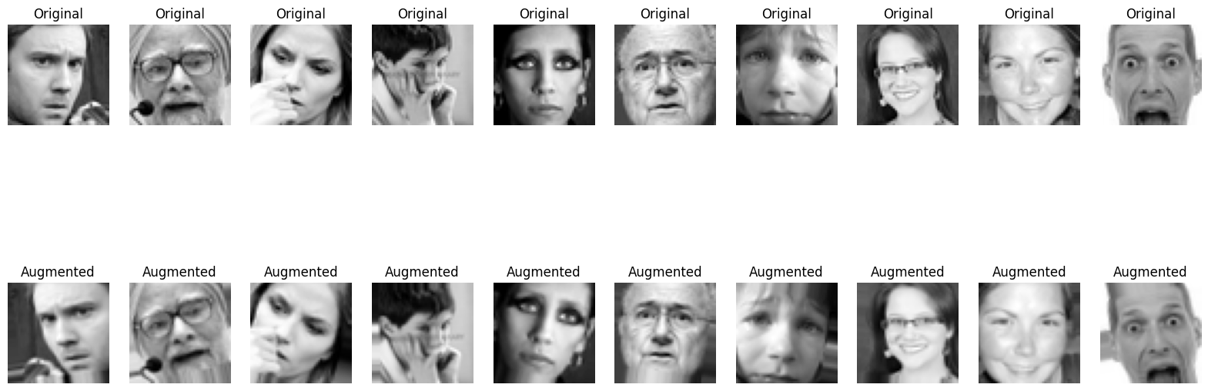
Augmentation
horizontal
flip
random
rotation
up to 15°
up to 10%
zoom
vertical
flip
vertical shift
up to 10%
horizontal shift
up to 10%
shear
up to 10%
Notes:
datagen = ImageDataGenerator(
rotation_range=15, # randomly rotate images by 15 degrees
width_shift_range=0.1, # randomly shift images horizontally by up to 10%
height_shift_range=0.1, # randomly shift images vertically by up to 10%
shear_range=0.1, # randomly apply shear transformation with a maximum shear intensity of 10%
zoom_range=0.1, # randomly zoom into images by up to 10%
horizontal_flip=True, # randomly flip images horizontally
fill_mode='nearest' # fill in newly created pixels after rotation or width/height shift
)

Slide 15
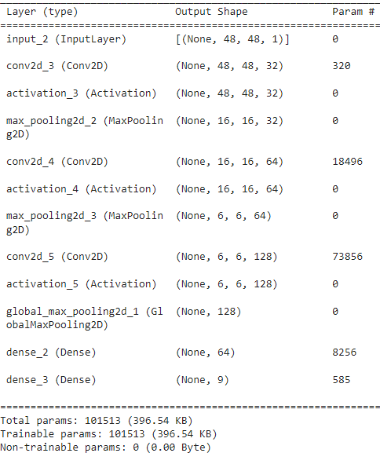
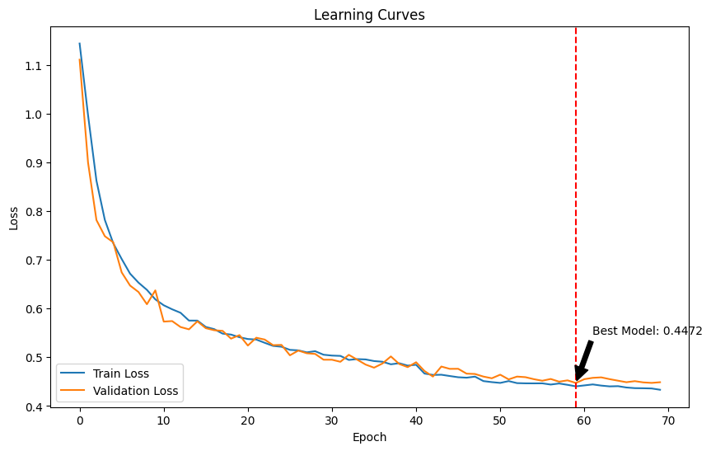
CNN 1
KLDivergence Loss

Slide 16
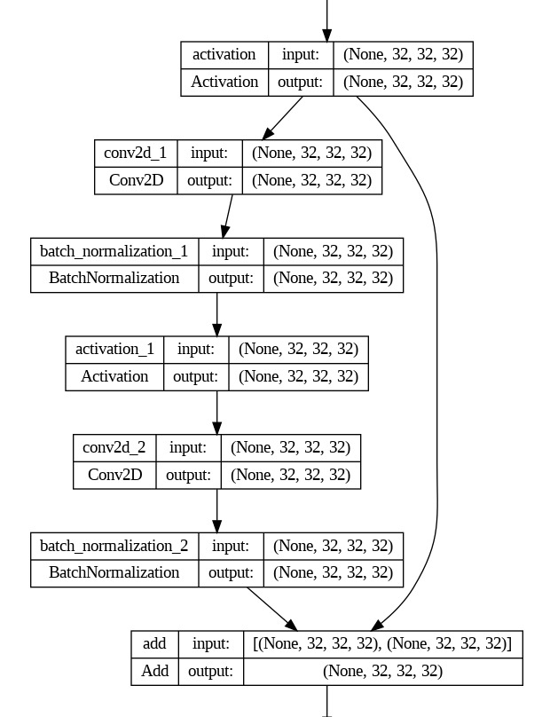
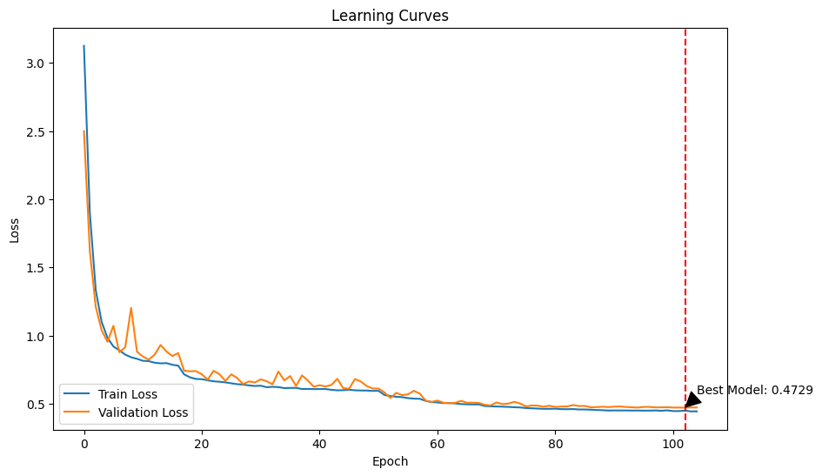
Residual Network
…
…

Slide 17
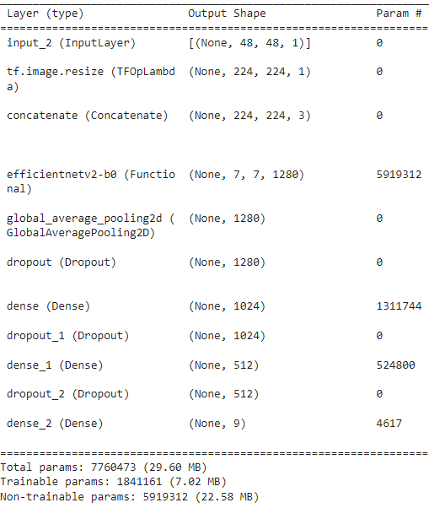
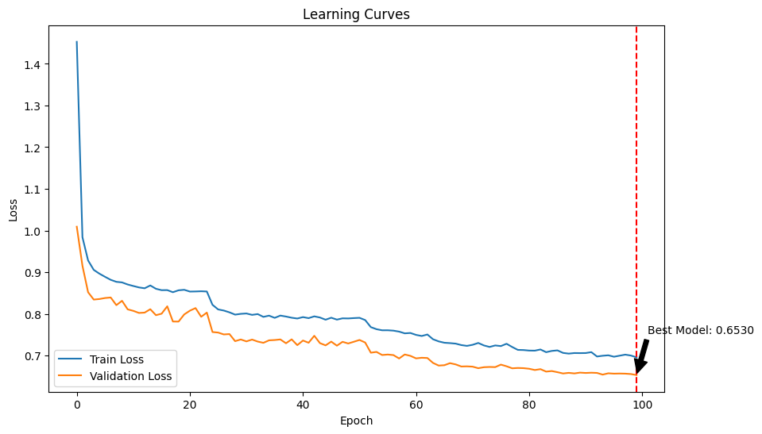
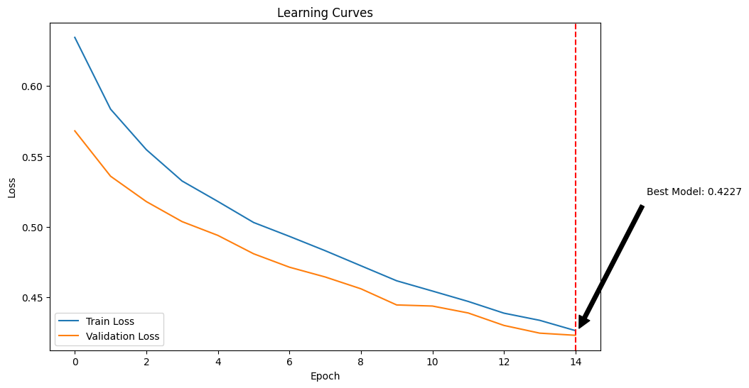
EfficientNet (Transfer Learning)
Fine tuning

Slide 18
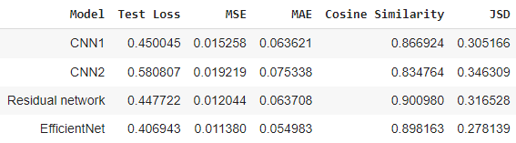
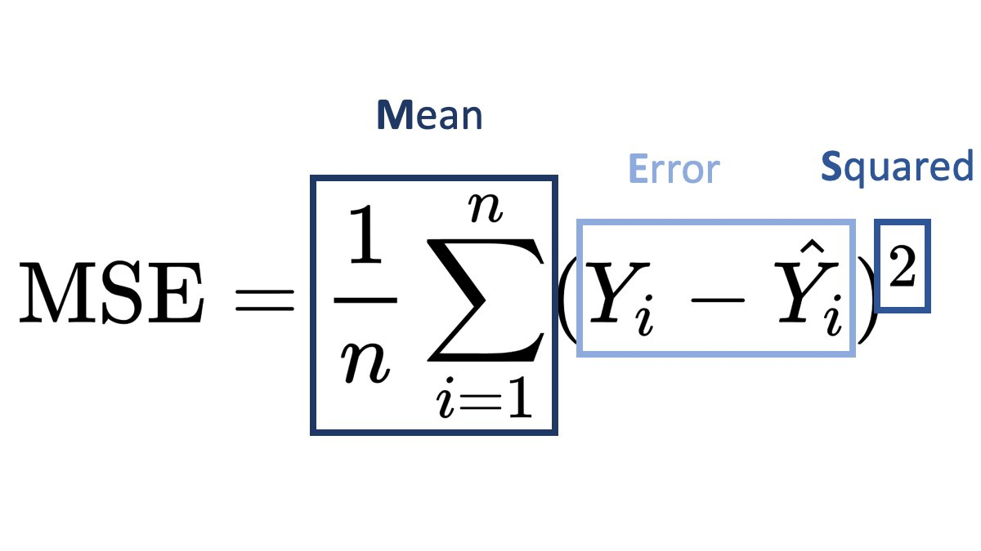
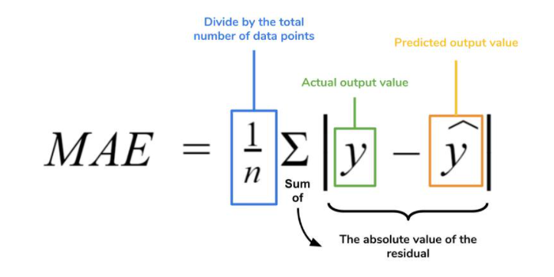
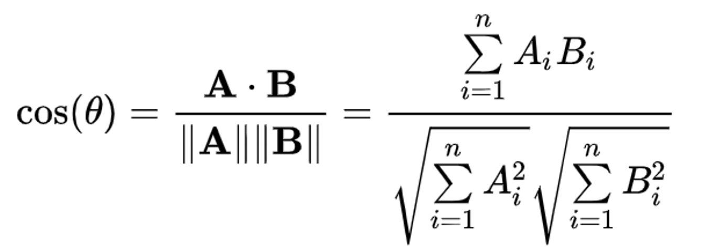
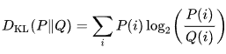
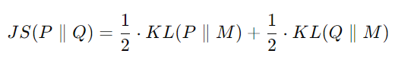
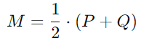
Model comparison
KLDivergence Loss
with
Notes:
https://yongchaohuang.github.io/2020-07-08-kl-divergence/

Slide 19
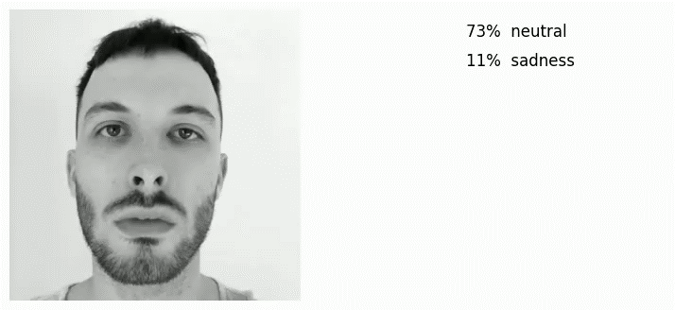
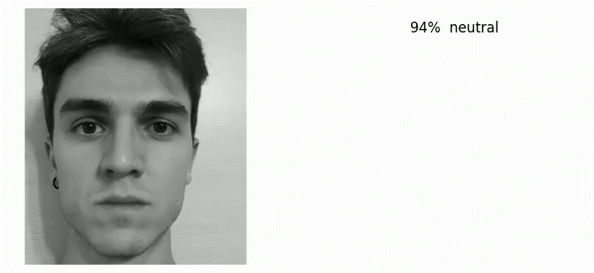
DEMO Emotion Recognition
ResNet
EfficientNet

Slide 20
03
VIP lookalike retrieval

Slide 21
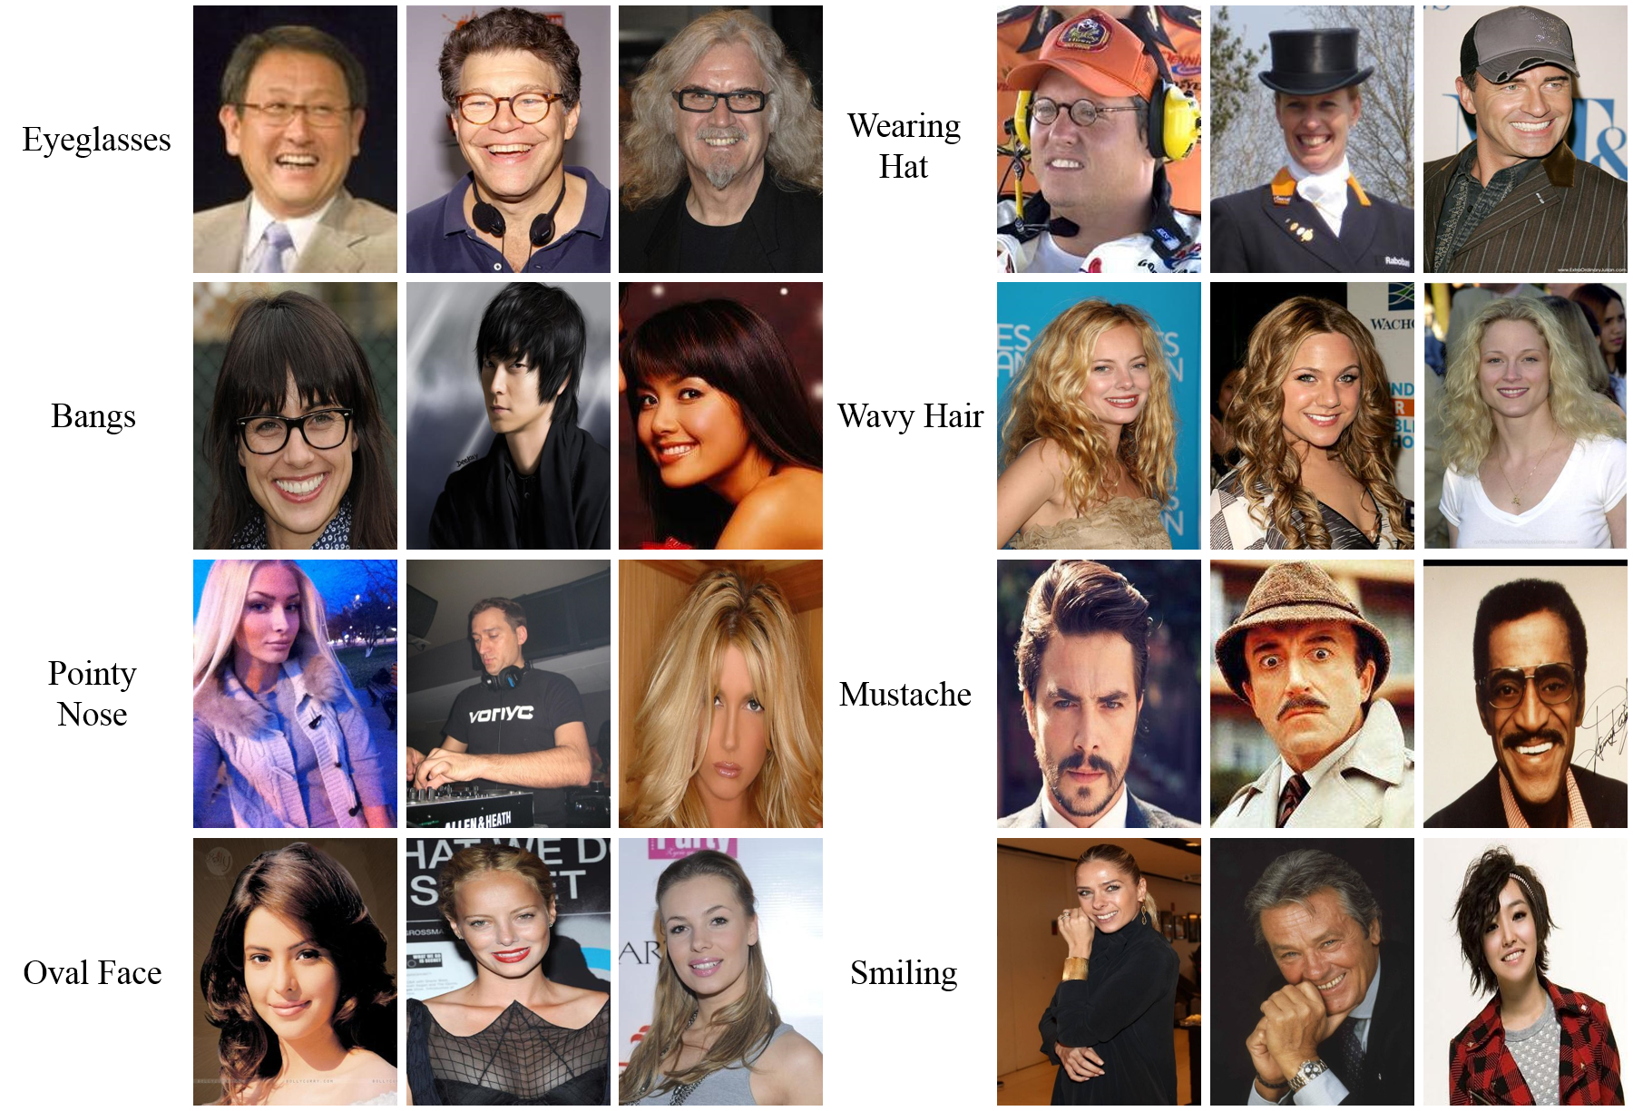
Dataset
CelebA (aligned) + CelebFaces Attributes (CelebA)
202,599 celebrities
10,177 unique

Slide 22
Feature extractors
MobileNetv2
VGGFace
ImageNet weights
Max pooling
224x224 (normalized)
Based on ResNet50 architecture
Avg pooling
224x224 (zero-centered)
KDTree
(Euclidean / Manhattan distance)
Applied only to the first 10000 images due to limited computational resources

Slide 23
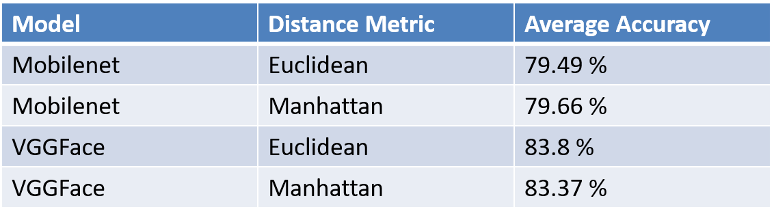
Evaluation (with attributes)
Extract
Evaluate
Features of the training set
Average accuracy
Compare to lookalike
95/5 split
Train-test
Attributes

Slide 24
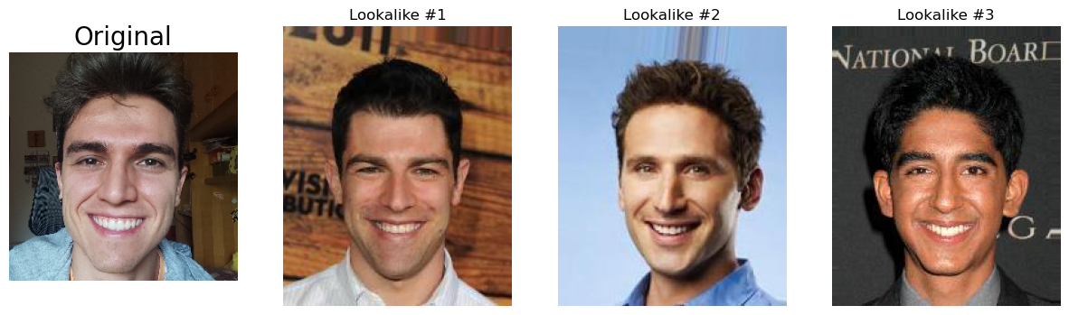
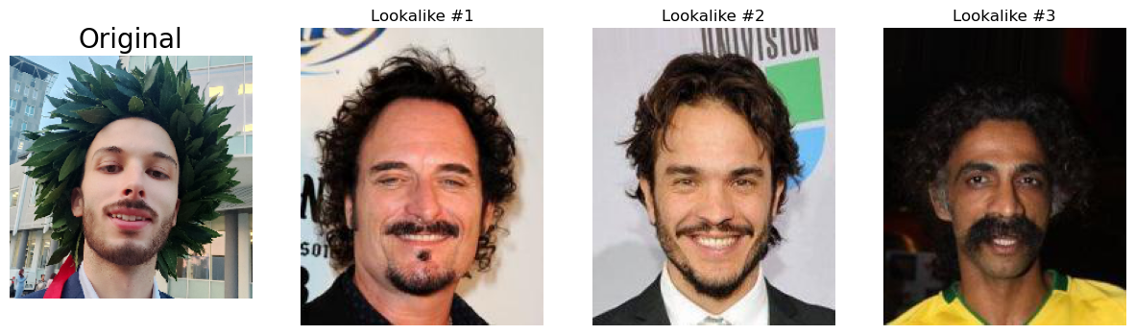
DEMO VIP Lookalike
VGG Eucl

